Slide 1
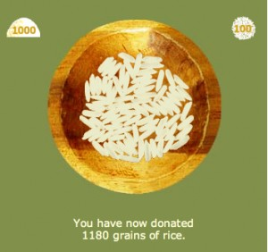
Rice Up on Vocab!
By Mr. Kazi

Slide 2
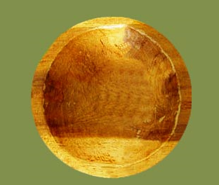
Teacher means:
map
instructor
label
fabric

Slide 3
Try Again!

Slide 4
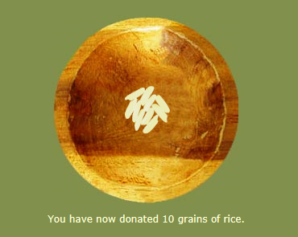
Correct!

Slide 5
Silent means:
great
last
ill
quiet

Slide 6
Try Again!
QUIT

Slide 7
Correct!
PASS

Slide 8
gifted means:

Slide 9
Try Again!
QUIT

Slide 10
Correct!
PASS

Slide 11
option means:
choice
sickness
goof
pity

Slide 12
Try Again!
QUIT

Slide 13
Correct!

