Slide 1
My Game Show
By Mr. Kazi

Slide 2
What time is it?
10:35
2:10
10:10
2:50

Slide 3
Try Again!

Slide 4
Correct!

Slide 5
How much money?
50 cents
40 cents
46 cents
41 cents

Slide 6
Try Again!
QUIT

Slide 7
Correct!
PASS

Slide 8
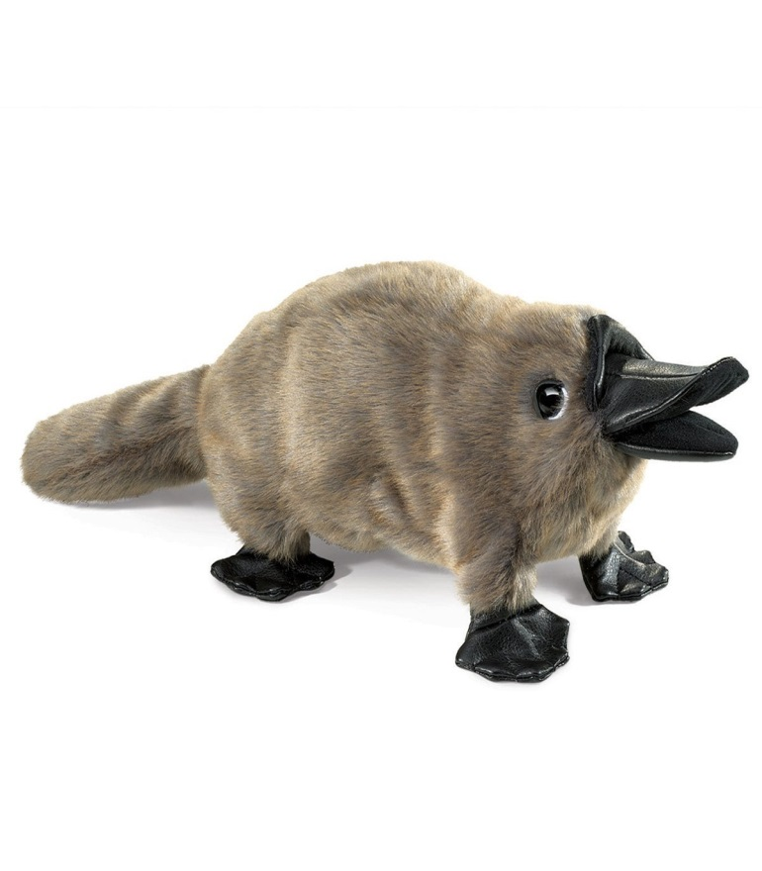
What is the name of this animal?
Rat
Mouse
Platypus
Weasel

Slide 9
Try Again!
QUIT

Slide 10
Correct!
PASS

Slide 11
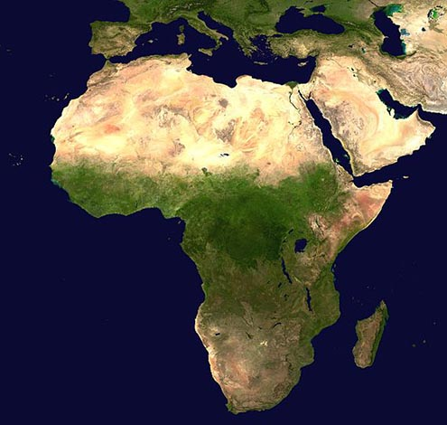
Which continent?
Asia
Africa
Europe
USA

Slide 12
Try Again!
QUIT

Slide 13
Correct!
PASS

Slide 14
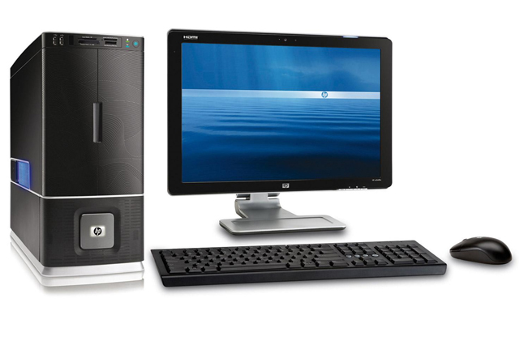
Name that computer part!
Keyboard
Monitor
Mouse

Slide 15
Try Again!
QUIT

Slide 16
Correct!
PASS

Slide 17
Name that computer part!
Keyboard
CPU
Mouse

Slide 18
Try Again!
QUIT

Slide 19
Correct!
PASS

Slide 20
Name that computer part!
Keyboard
Monitor
CPU

Slide 21
Try Again!
QUIT

Slide 22
Correct!
PASS

Slide 23
Name that computer part!
Keyboard
Monitor
Mouse

Slide 24
Try Again!
QUIT

Slide 25
Correct!
PASS

